Slide 1


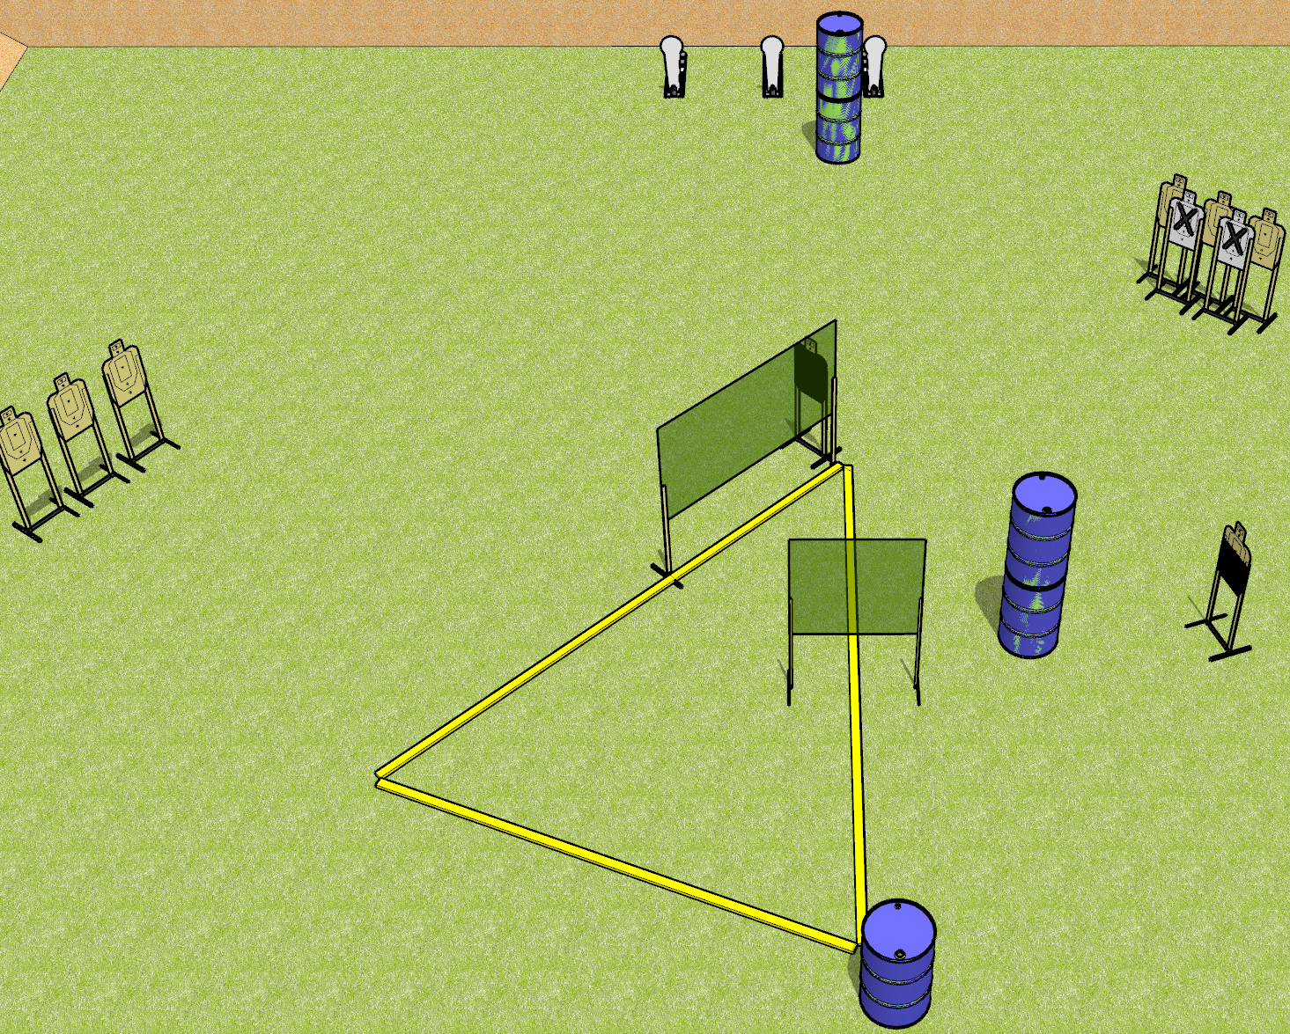
 | Dothan Gun Club – USPSA Match Tap Rack Bang Course Designer : Drew Coleman
START POSITION : Standing outside the shooting area, palms flat on marks on barrel. PCC muzzle touching either mark.
GUN READY CONDITION : Pistol with empty chamber, hammer down, magazine inserted, and holstered. PCC with empty chamber, hammer down, magazine inserted, held with both hands, shouldered, muzzle touching either mark. |  | SCORING: Comstock, 11 rounds TARGETS: 8 paper, 3 Steel SCORED HITS: Best 1 on paper, steel until down START-STOP: Audible, last shot RULES:
STAGE PROCEDURE: Engage targets as they become available from within the fault lines.

Slide 2
Tap Rack Bang
Written Stage Briefing
Tap Rack Bang is an 11 round, 55 point, Comstock short course. There are eight USPSA targets and three colt poppers. The best hit on paper will score, and steel must fall to score. The start signal is audible.
Handgun start position is outside the shooting area, palms flat on marks on barrel. Pistol is holstered with magazine inserted, empty chamber, hammer down.
PCC start position is outside the shooting area, muzzle touching either mark. Carbine is held with both hands, empty chamber, hammer down, magazine inserted.
On start signal, engage targets as they become available from within the shooting area.

Slide 3
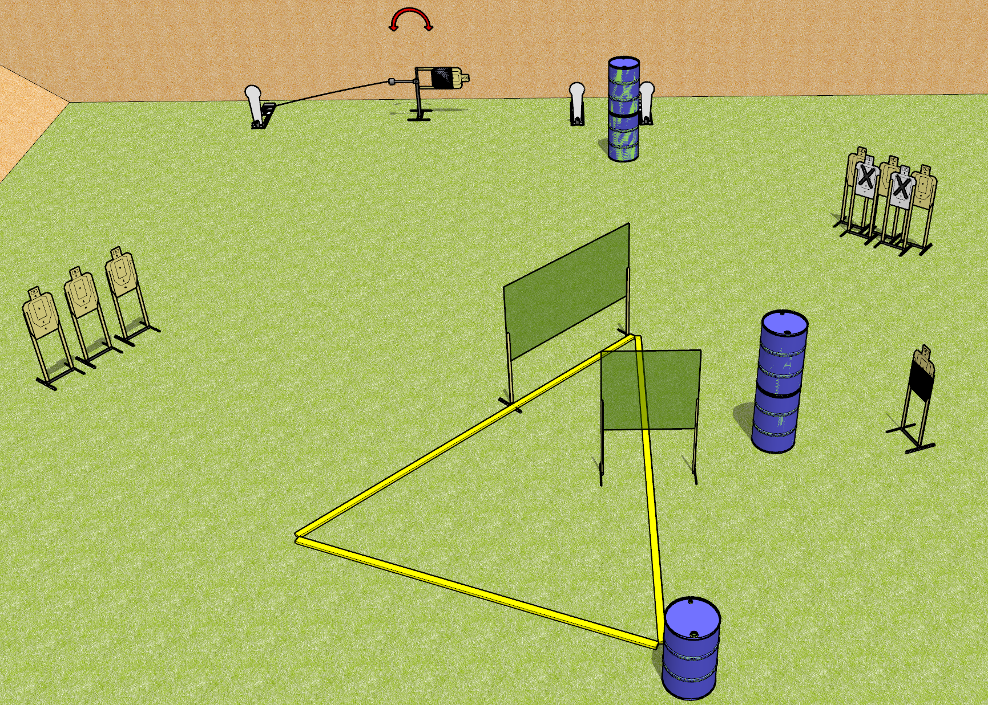
 | Dothan Gun Club – USPSA Match Tap Rack Bang Course Designer : Drew Coleman
START POSITION : Outside the shooting area, palms flat on marks on barrel.
GUN READY CONDITION : Firearm with empty chamber, hammer down, magazine inserted. Firearm is placed on barrel between hands, pointing downrange. |  | SCORING: Comstock, 11 rounds TARGETS: 8 paper, 3 Steel SCORED HITS: Best 1 on paper, steel until down START-STOP: Audible, last shot RULES:
STAGE PROCEDURE: Engage targets as they become available from within the fault lines.

Slide 4
Tap Rack Bang
Written Stage Briefing
Tap Rack Bang is an 11 round, 55 point, Comstock short course. There are eight USPSA targets and three colt poppers. The best hit on paper will score, and steel must fall to score. The start signal is audible.
The swinger is activated by the far left popper. Please check the activator prior to walkthrough and set it the same way for each shooter.
Start position is outside the shooting area, palms flat on marks on barrel. Firearm is on barrel between hands, pointing down range, with an empty chamber, hammer down, magazine inserted.
On start signal, engage targets as they become available from within the shooting area.

